Slide 1
Computational Thinking & Systems Design Lecture 11 Compiler II: Generating VM Code
Ben Koo
November 24, 2020

Slide 2
Course map
Human
Abstract design
Software
Thought
abstract interface
hierarchy
Chapters 9, 12
H.L. Language
Compiler
&
abstract interface
Operating Sys.
Chapters 10 - 11
Virtual
VM Translator
Machine
abstract interface
Chapters 7 - 8
Assembly
Language
Assembler
Chapter 6
abstract interface
Computer
Machine
Architecture
Language
abstract interface
Chapters 4 - 5
Gate Logic
Hardware
abstract interface
Platform
Chapters 1 - 3
Electrical
Hardware
Chips &
Engineering
Logic Gates
Physics
hierarchy

Slide 3
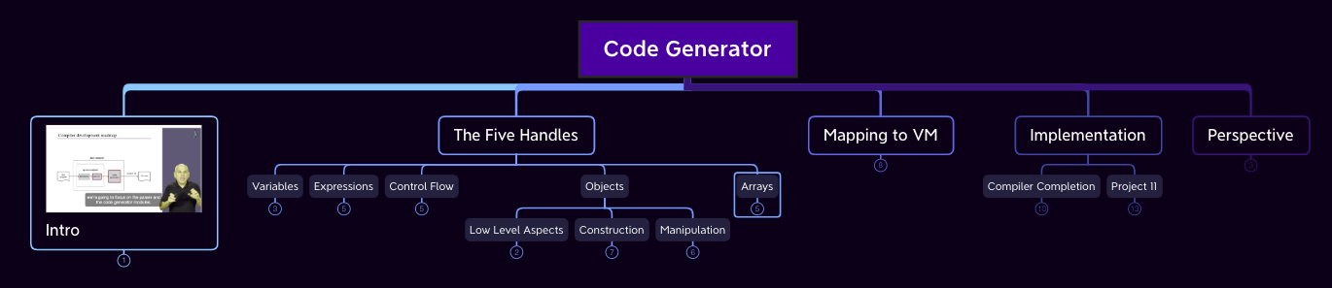
Lecture Map

Slide 4
The big picture
1. Syntax analysis: extracting the semantics from the source code
2. Code generation: expressing the semantics using the target language
previous lecture
this lecture

Slide 5
Syntax analysis (review)
Class Bar { method Fraction foo(int y) { var int temp; // a variable let temp = (xxx+12)*-63; ...
...
<varDec>
<keyword> var </keyword>
<keyword> int </keyword>
<identifier> temp </identifier>
<symbol> ; </symbol>
</varDec>
<statements>
<letStatement>
<keyword> let </keyword>
<identifier> temp </identifier>
<symbol> = </symbol>
<expression>
<term>
<symbol> ( </symbol>
<expression>
<term>
<identifier> xxx </identifier>
</term>
<symbol> + </symbol>
<term>
<int.Const.> 12 </int.Const.> </term>
</expression>
...
Syntax analyzer
The code generation challenge:
Program = a series of operations that manipulate data
Compiler: converts each “understood” (parsed) source operation and data item into corresponding operations and data items in the target language
Thus, we have to generate code for
handling data
handling operations
Our approach: morph the syntax analyzer (project 10) into a full-blown compiler: instead of generating XML, we’ll make it generate VM code.

Slide 6
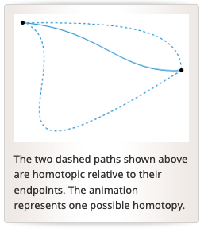
Translation visualized in a Geometrical Sense (Homotopy)
Class Bar { method Fraction foo(int y) { var int temp; // a variable let temp = (xxx+12)*-63; ...
...
<varDec>
<keyword> var </keyword>
<keyword> int </keyword>
<identifier> temp </identifier>
<symbol> ; </symbol>
</varDec>
<statements>
<letStatement>
<keyword> let </keyword>
<identifier> temp </identifier>
<symbol> = </symbol>
<expression>
<term>
<symbol> ( </symbol>
<expression>
<term>
<identifier> xxx </identifier>
</term>
<symbol> + </symbol>
<term>
<int.Const.> 12 </int.Const.> </term>
</expression>
...
Syntax analyzer

Slide 7
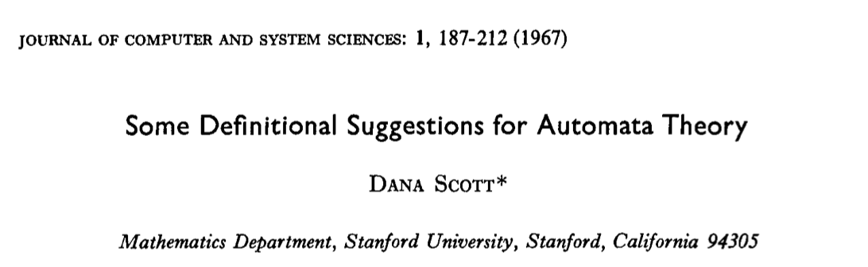
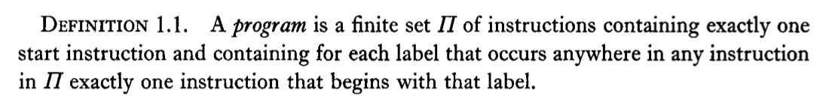
Definitional Suggestion for Computing Science

Slide 8
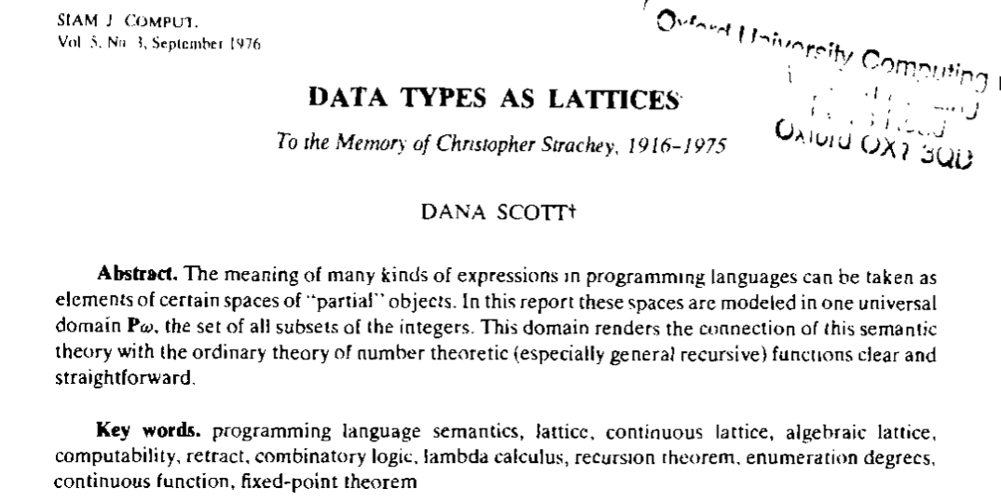

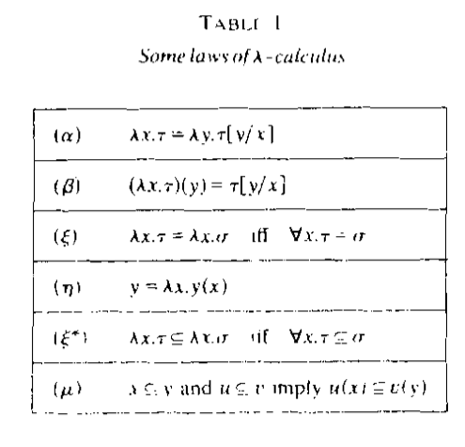
All meaningful expressions can be modeled as $𝒫ω$
Prof. Dana Stewart Scott
Image Source: Britannica

Slide 9
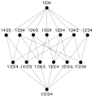
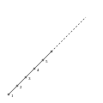
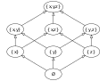
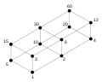
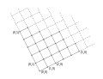
What is a Lattice?
Pic. 1: Subsets of {x, y, z}, under set inclusion. The name "lattice" is suggested by the form of the Hasse diagram depicting it.
Pic. 2: Lattice of integer divisors of 60, ordered by "divides".
Pic. 3: Lattice of partitions of {1, 2, 3, 4}, ordered by "refines".
Pic. 4: Lattice of positive integers, ordered by ≤.
Pic. 5: Lattice of nonnegative integer pairs, ordered component wise.
Source of Images and Text : https://en.wikipedia.org/wiki/Lattice_(order)

Slide 10
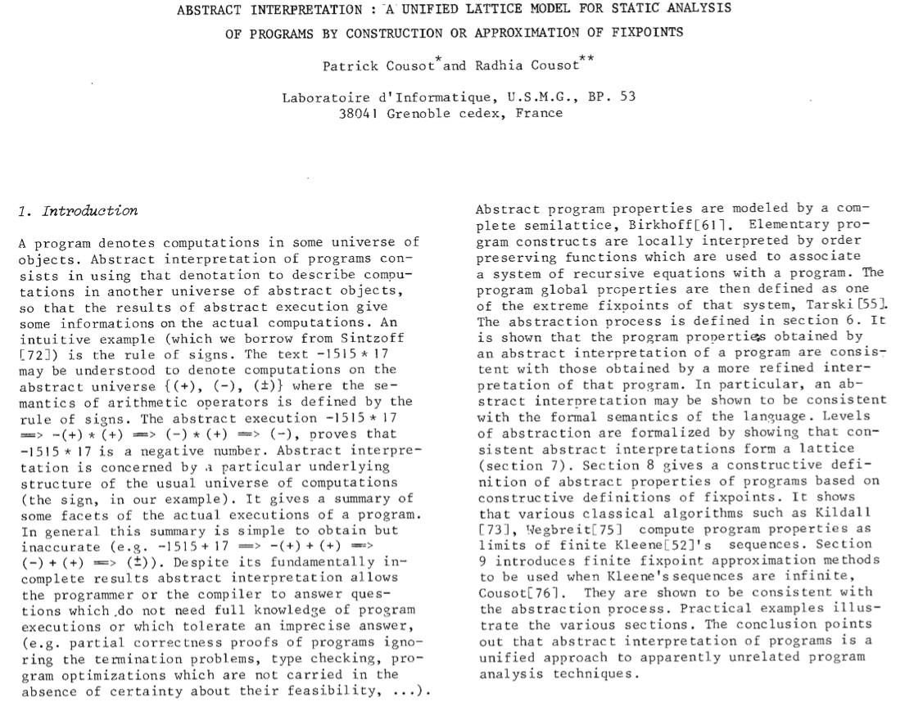
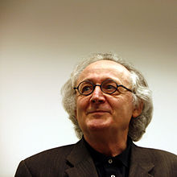

Lattice represents a Universal Data Type
Patrick Cousot
Radhia Cousot
Source of Text : https://www.di.ens.fr/~cousot/publications.www/CousotCousot-POPL-77-ACM-p238--252-1977.pdf

Slide 11
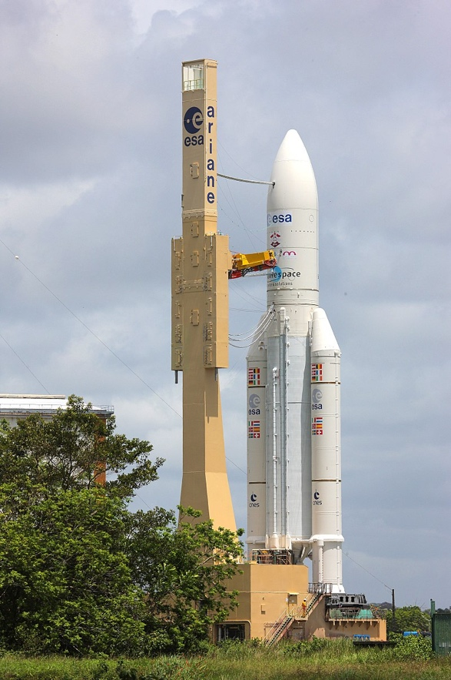
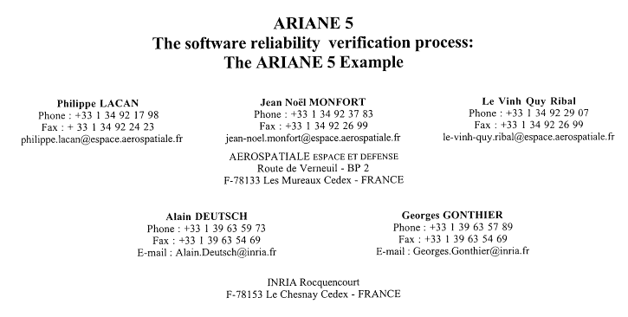
An Example of (not) Computing in Lattice Space
Image Source: Wikipedia

Slide 12
Memory segments (review)
VM memory Commands:
pop segment i
push segment i
Where i is a non-negative integer and segment is one of the following:
static: holds values of global variables, shared by all functions in the same class
argument: holds values of the argument variables of the current function
local: holds values of the local variables of the current function
this: holds values of the private (“object”) variables of the current object
that: holds array values (silly name, sorry)
constant: holds all the constants in the range 0 … 32767 (pseudo memory segment)
pointer: used to anchor this and that to various areas in the heap
temp: fixed 8-entry segment that holds temporary variables for general use; Shared by all VM functions in the program.

Slide 13

Code generation example
method int foo() {
var int x;
let x = x + 1;
...
<letStatement>
<keyword> let </keyword>
<identifier> x </identifier>
<symbol> = </symbol>
<expression>
<term>
<identifier> x </identifier>
</term>
<symbol> + </symbol>
<term>
<constant> 1 </constant> </term>
</expression>
</letStatement>
Code generation
Syntax analysis
push local 0
push constant 1
add
pop local 0
(note that x is the first local variable declared in the method)

Slide 14
Handling variables
When the compiler encounters a variable, say x, in the source code, it has to know:
What is x’s data type? Primitive, or ADT (class name) ? (Need to know in order to properly allocate RAM resources for its representation)
What kind of variable is x? local, static, field, argument ? ( We need to know in order to properly allocate it to the right memory segment; this also implies the variable’s life cycle ).

Slide 15
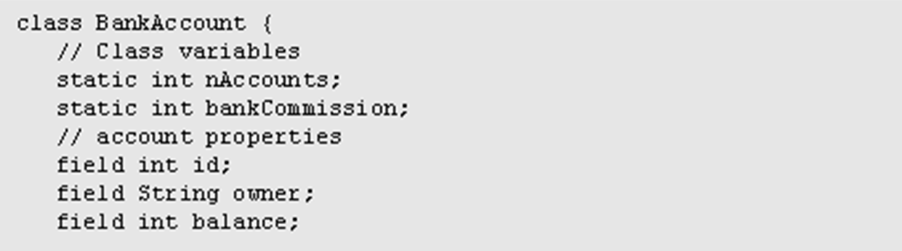
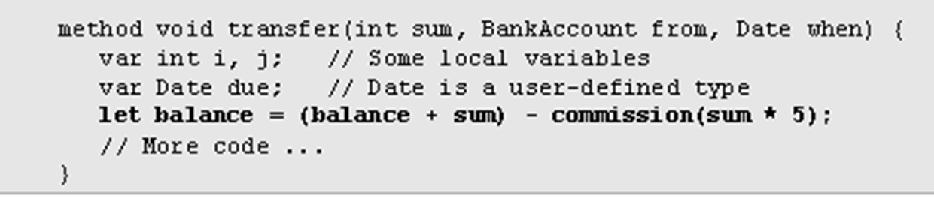
Handling variables: mapping them on memory segments (example)
The target language uses 8 memory segments
Each memory segment, e.g. static, is an indexed sequence of 16-bit values that can be referred to as static 0, static 1, static 2, etc.
When compiling this class, we have to create the following mappings:
The class variables nAccounts , bankCommission are mapped on static 0,1
The object fields id, owner, balance are mapped on this 0,1,2
The argument variables sum, bankAccount, when are mapped on arg 0,1,2
The local variables i, j, due are mapped on local 0,1,2.

Slide 16
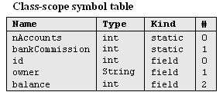
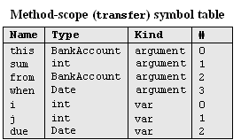
Handling variables: symbol tables
How the compiler uses symbol tables:
The compiler builds and maintains a linked list of hash tables, each reflecting a single scope nested within the next one in the list
Identifier lookup works from the current symbol table back to the list’s head
(a classical implementation).

Slide 17

Handling variables: managing their life cycle
Variables life cycle
static variables: single copy must be kept alive throughout the program duration
field variables: different copies must be kept for each object
local variables: created on subroutine entry, killed on exit
argument variables: similar to local variables.
Good news: the VM implementation already handles all these details !

Slide 18
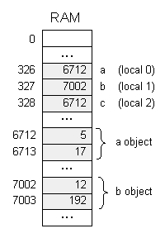
Handling objects: construction / memory allocation
Java code
class Complex {
// Fields (properties):
int re; // Real part
int im; // Imaginary part
...
/** Constructs a new Complex number */
public Complex (int re, int im) {
this.re = re;
this.im = im;
}
...
}
class Foo {
public void bla() {
Complex a, b, c;
...
a = new Complex(5,17);
b = new Complex(12,192);
...
c = a; // Only the reference is copied
...
}
Following compilation:
How to compile:
foo = new ClassName(…) ?
The compiler generates code affecting:
foo = Memory.alloc(n)
Where n is the number of words necessary to represent the object in question, and Memory.alloc is an OS method that returns the base address of a free memory block of size n words.

Slide 19
Handling objects: accessing fields
Java code
class Complex {
// Properties (fields):
int re; // Real part
int im; // Imaginary part
...
/** Constructs a new Complex number */
public Complex(int re, int im) {
this.re = re;
this.im = im;
}
...
/** Multiplies this Complex number
by the given scalar */
public void mult (int c) {
re = re * c;
im = im * c;
}
...
}
How to compile:
im = im * c ?
1. look up the two variables in the symbol table
2. Generate the code:
*(this + 1) = *(this + 1) times (argument 0)
This pseudo-code should be expressed in the target language.

Slide 20
Handling objects: establishing access to the object’s fields
Background: Suppose we have an object named b of type Ball. A Ball has x,y coordinates, a radius, and a color.
Assume that b and r were passed to the function as its first two arguments.
How to compile (in Java):
b.radius = r ?
// Get b's base address:
push argument 0
// Point the this segment to b:
pop pointer 0
// Get r's value
push argument 1
// Set b's third field to r:
pop this 2

Slide 21
Handling objects: method calls
Java code
How to compile:
x.mult(5) ?
This method call can also be viewed as:
mult(x,5)
Generate the following code:
class Complex {
// Properties (fields):
int re; // Real part
int im; // Imaginary part
...
/** Constructs a new Complex object. */
public Complex(int re, int im) {
this.re = re;
this.im = im;
}
...
}
class Foo {
...
public void bla() {
Complex x;
...
x = new Complex(1,2);
x.mult(5);
...
}
}
push x
push 5
call mult
General rule: each method call
foo.bar(v1,v2,...)
is translated into:
push foo
push v1
push v2
...
call bar

Slide 22
Handling arrays: declaration / construction
Java code
RAM state
class Bla {
...
void foo(int k) {
int x, y;
int[] bar; // declare an array
...
// Construct the array:
bar = new int[10];
...
bar[k]=19;
}
...
Main.foo(2); // Call the foo method
...
0
...
275
x
(local 0)
276
y
(local 1)
277
4315
bar
(local 2)
Following compilation:
...
504
...
2
k
(argument 0)
4315
4316
4317
19
(bar array)
4318
...
4324
...
How to compile:
bar = new int(n) ?
Generate code affecting:
bar = Memory.alloc(n)

Slide 23
Handling arrays: accessing an array entry by its index
Java code
RAM state, just after executing bar[k] = 19
class Bla {
...
void foo(int k) {
int x, y;
int[] bar; // declare an array
...
// Construct the array:
bar = new int[10];
...
bar[k]=19;
}
...
Main.foo(2); // Call the foo method
...
0
...
275
x
(local 0)
276
y
(local 1)
277
4315
bar
(local 2)
Following compilation:
...
504
...
2
k
(argument 0)
4315
4316
4317
19
(bar array)
4318
...
How to compile: bar[k] = 19 ?
4324
...
VM Code (pseudo)
VM Code (actual)
// bar[k]=19, or *(bar+k)=19
push bar
push k
add
// Use a pointer to access x[k]
pop addr // addr points to bar[k]
push 19
pop *addr // Set bar[k] to 19
// bar[k]=19, or *(bar+k)=19
push local 2
push argument 0
add
// Use the that segment to access x[k]
pop pointer 1
push constant 19
pop that 0
Notes:
23

Slide 24
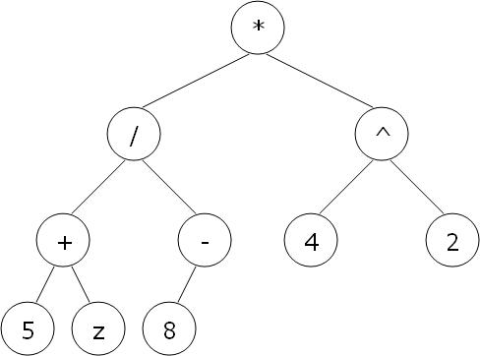
Handling expressions
High-level code
parse tree
VM code
((5+z)/-8)*(4^2)
syntax analysis
code generation
push 5
push z
add
push 8
neg
call div
push 4
push 2
call power
call mult
To generate VM code from a parse tree exp, use the following logic:
The codeWrite(exp) algorithm:
if exp is a constant n then output "push n"
if exp is a variable v then output "push v"
if exp is op(exp₁) then codeWrite(exp₁); output "op";
if exp is (exp₁ op exp₂) then codeWrite(exp₁); codeWrite(exp₂); output "op";
if exp is f (exp₁, ..., exp_{n}) then codeWrite(exp1); ... codeWrite(exp1); output "call f";

Slide 25
Handling program flow
High-level code
VM code
if (cond)
s1
else
s2
...
VM code to compute and push !(cond)
if-goto L1
VM code for executing s1
goto L2
label L1
VM code for executing s2
label L2
...
code generation
High-level code
VM code
while (cond)
s
...
label L1
VM code to compute and push !(cond)
if-goto L2
VM code for executing s
goto L1
label L2
...
code generation

Slide 26
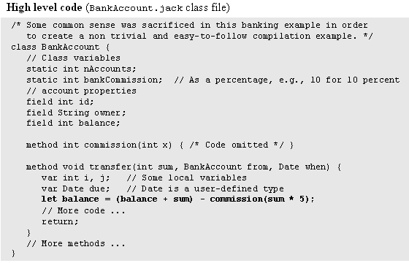
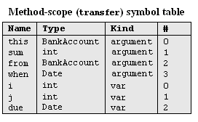
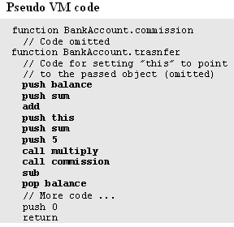
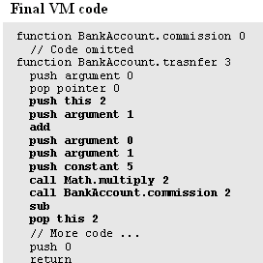
Final example

Slide 27
Perspective
Jack simplifications that are challenging to extend:
Limited primitive type system
No inheritance
No public class fields, e.g. must use r = c.getRadius() rather than r = c.radius
Jack simplifications that are easy to extend: :
Limited control structures, e.g. no for, switch, …
Cumbersome handling of char types, e.g. cannot use let x=‘c’
Optimization
For example, c=c+1 is translated inefficiently into push c, push 1, add, pop c.
Parallel processing
Many other examples of possible improvements …

Slide 28
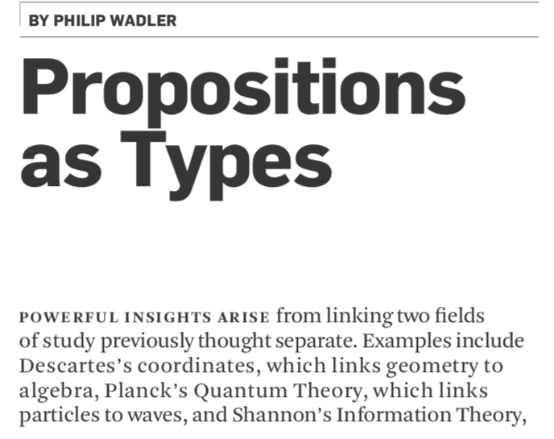
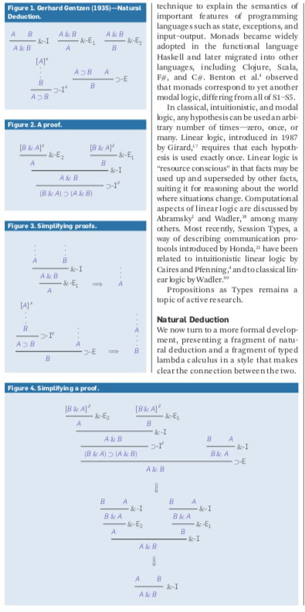
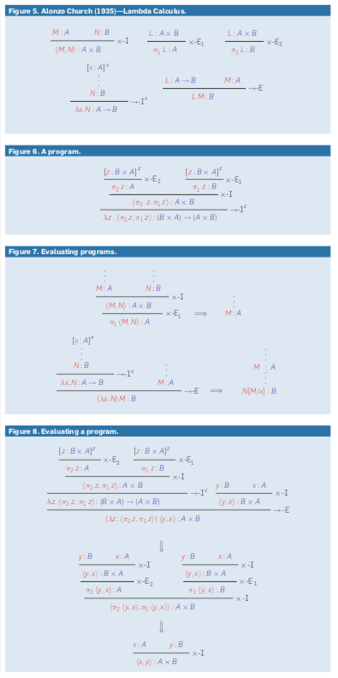
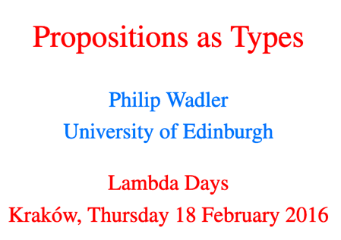
Translation between Types and Propositions

Slide 29
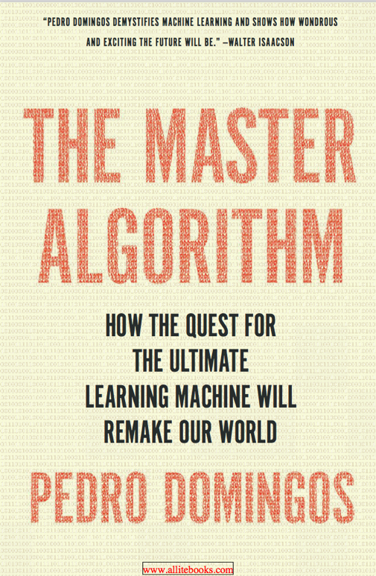
The Universal Algorithm?
The central hypothesis:
All Knowledge – past, present, and future can be derived from data by a single universal learning algorithm
Pedro Domingos, TMA, P. 25
中译本

Slide 30
The Master Equation?

Slide 31
Production Rules =>

Slide 32
CFG Production Rules
http://www.diva-portal.se/smash/get/diva2:934721/FULLTEXT01.pdf

Slide 33
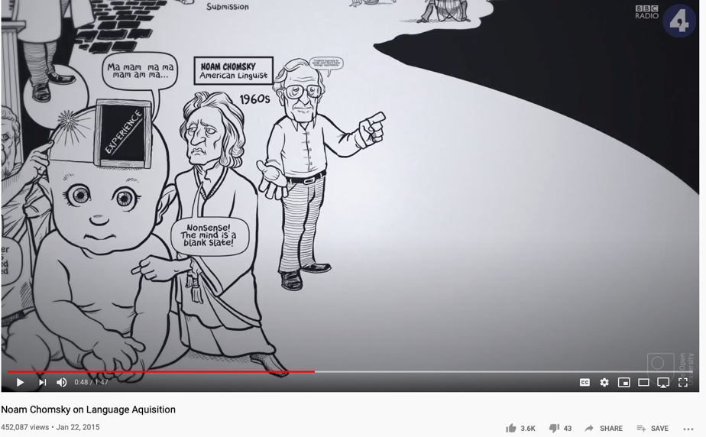

Chomsky’s Universal Grammar
Also see: Are you smarter than a Chimp?
https://youtu.be/7Cgpfw4z8cw?t=48
Language Design - Noam Chomsky / Serious Science

Slide 34
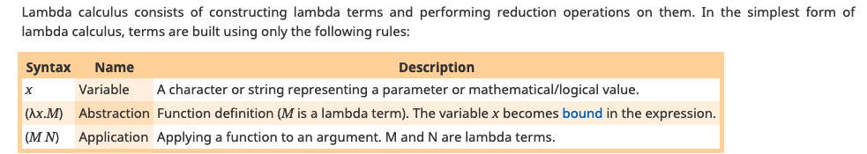

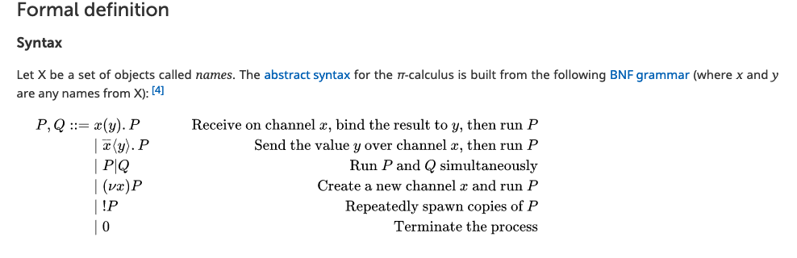
Lambda and Pi-Calculus

